Slide 1
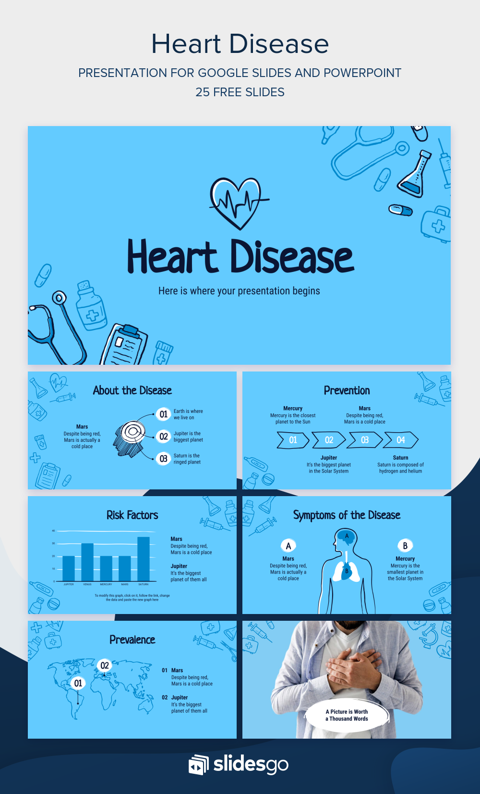
Heart Disease Prediction
With
Data and Analytics
Science

Slide 2


Heart Disease Prediction using Data Science and Data Analytics
Project By –
Pranay Nitin Pachangane
Gayatri Anand Nadar
Harshada Yuvraj Khairnar

Slide 3

Heart Disease
Heart conditions that include diseased vessels, structural problems and blood clots.
The term “heart disease” refers to several types of heart conditions. The most common type of heart disease in the United States is coronary artery disease (CAD), which affects the blood flow to the heart. Decreased blood flow can cause a heart attack.

Slide 4

Introduction
Heart disease refers to any condition affecting the cardiovascular system. There are several different types of heart disease, and they affect the heart and blood vessels in different ways.
Coronary artery disease, also known as coronary heart disease, is the most common type of heart disease.
It develops when the arteries that supply blood to the heart become clogged with plaque. This causes them to harden and narrow. Plaque contains cholesterol and other substances.

Slide 5
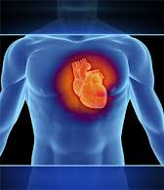
Problem Statement And Proposed Solution
PROBLEM STATEMENT:
As we know due to day-to-day busy & stressful scheduled life almost all people’s didn’t give any importance to their body health
So there is a need to predict the large amount of data to analise whether a particular person having a heart disease or not.
PROPOSED SOLUTION:
So, with the help of logistic regression it’s very easy to predict the disease easily irrespective to how big is the data.

Slide 6
System Architecture
Dataset
Data understanding and preprocessing
Data Visualization
Machine learning models
Result

Slide 7
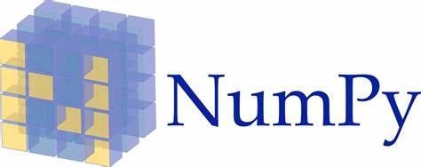



Libraries in project :
Libraries used in this project are
Pandas
NumPy
Sci-kit learn
Matplotlib

Slide 8
Data Analysis
For this project we have used the dataset heart_disease.csv. This dataset contains total 303 instances and 14 attributes. The attributes in the dataset are:
Attributes | Description
Age | Age of an individual
Sex | Gender of an individual
Chest pain type | Type of chest pain experience by a person which are 0 - typical angina 1 – non-typical 2 - non-anginal pain 3 – asymptomatic
Rest BP | Blood pressure of an individual
Chol | Serum cholesterol level of an individual
Fasting blood sugar(Fbs) | Record if the fasting blood sugar level is greater than 120 or not
Rest ECG | ECG result of an individual

Slide 9
Data Analysis
Attributes | Description
Max HR | Maximum number of heart beats per minute of an individual
Exercise induced angina(ExAng) | Record whether an individual have angina during or after exercising
Old peak | Value of ST depression induced by exercise relative to rest on ECG plot
Slope | Slope of peak exercise ST segment
Ca | Number of major vessels colored by fluoroscopy
Thal | Displays Thalassemia, an inherited blood disorder characterized by the formation of abnormal form of hemoglobin
AHD | AHD stands for atherosclerotic heart disease

Slide 10
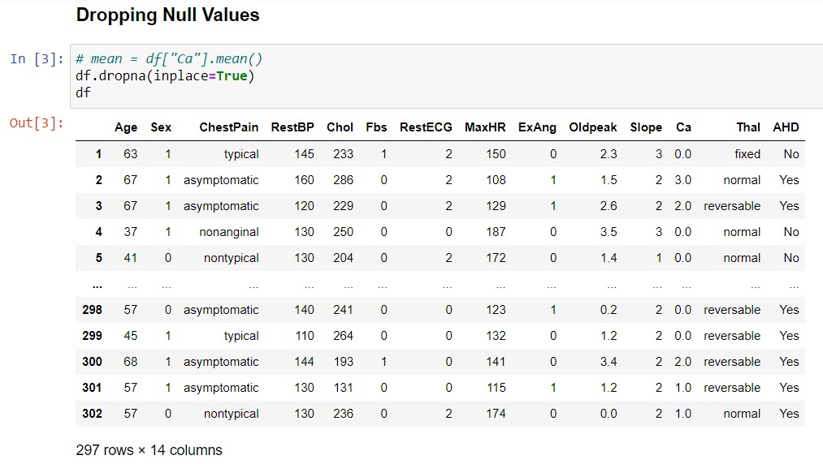
Data Pre-Processing
This dataset contains 303 records, no null values, all the records are of integer and float datatype.
The target attribute has almost equal number of both the values, so we can say that this dataset is balance and there is no need of further processing.

Slide 11
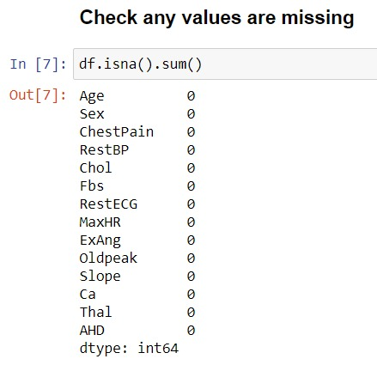
Data Pre-Processing

Slide 12
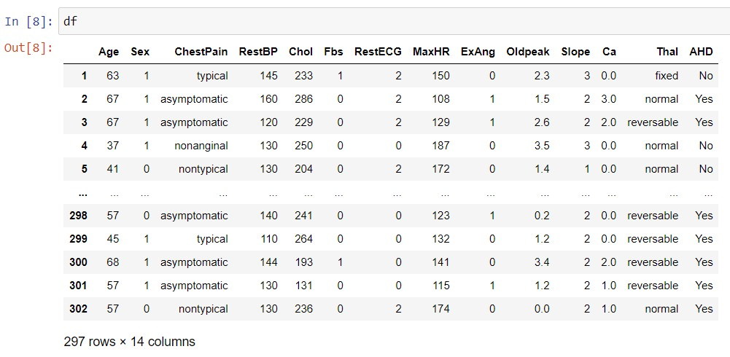
Data Pre-Processing

Slide 13
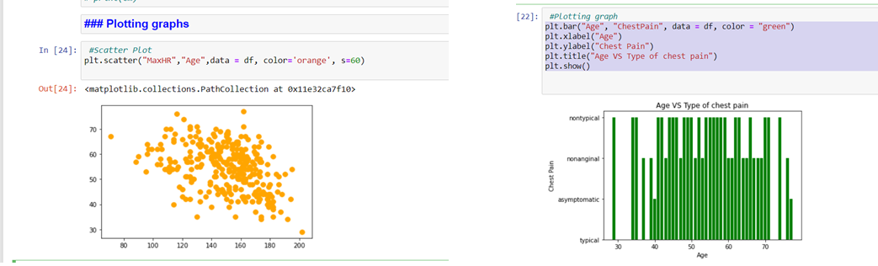
Data visualization
SCATTER PLOT
Max HR vs age

Slide 14
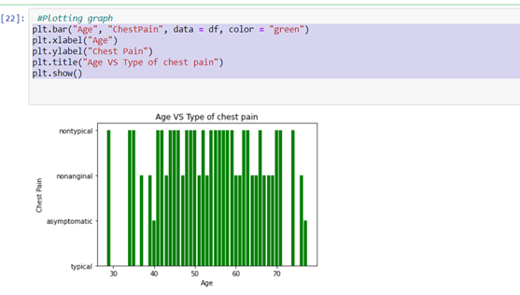
Data Visualization
BAR PLOT
Age vs type of chest pain

Slide 15
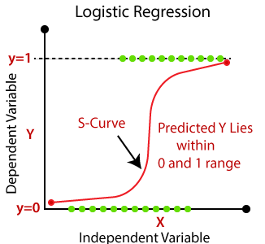
Model Building
There are two kinds of algorithms used in the project for model building purpose.
Logistic Regression:
Logistic regression is a supervised learning classification algorithm used to predict the probability of a target variable
A regression with an outcome variable that is categorical (e.g. success/failure) and explanatory variables that can be a mix of continuous and categorical variables.
It is used for predicting the categorical dependent variable using a given set of independent variables. Logistic Regression is a significant algorithm because it has the ability to provide probabilities and classify new data using continuous and discrete datasets.

Slide 16
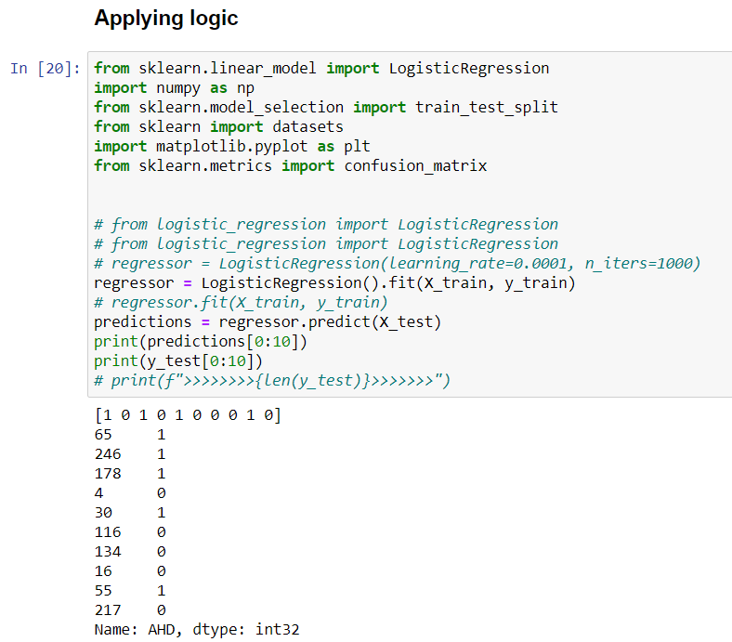
Model Building: Logistic Regression
Result of logistic regression for training data

Slide 17
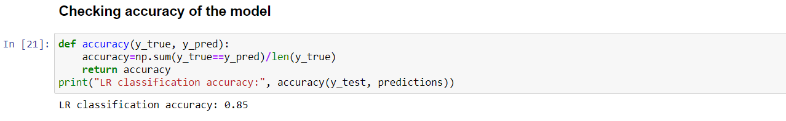
Model Building: Logistic Regression
Result of logistic regression for testing data

Slide 18
Conclusion
This project is data science and data anylatics Model for prediction of presence of heart disease using the dataset of records of 303 individuals.
First studied and processed the data, then used different visualization techniques to understand the data better.
Divided the dataset into testing and training sets and used Logistic Regression to train and test the datasets.
With Logistic regression, the accuracy is of 85%.

